Slide 1


Slide 2
valdis iljuconoks
(aka technical fellow)

Slide 3




valdis iljuconoks (aka technical fellow)
tech guy at getadigital.com
(Microsoft .Net + EPiServer) ◦ MVP
@tech_fellow

Slide 4
Azure Functions + Cognitive Services = Love Story
Notes:
https://martinfowler.com/articles/serverless.html

Slide 5
Serverless?
H
Notes:
H
It’s a horrible naming. Of course there is a server, but you just don’t manage that.
There is no magic – somebody else is managing the servers and you instantly get runtimes to host/run you code.

Slide 6
"Serverless is to servers as JavaScript is to Java."
-- Dave Cheney

Slide 7
Azure Functions is a serverless compute service that enables you to run code on-demand without having to explicitly provision or manage infrastructure.
Use Azure Functions to run a script or piece of code in response to a variety of events.
H
Notes:
H

Slide 8
Azure Functions is a serverless compute service that enables you to run code on-demand without having to explicitly provision or manage infrastructure.
Use Azure Functions to run a script or piece of code in response to a variety of events.
Notes:
H
Running server applications without managing infra
Has concrete restrictions
Deployments are different
H-scaling is done automatically
Triggered by events (binding)

Slide 9
Azure Serverless Components
H

Slide 10



Event Grid
Logic Apps
Functions
Serverless Events
Serverless Workflow
Serverless Compute
Notes:
Simplify your event-based apps with Event Grid, a single service for managing routing of all events from any source to any destination. Designed for high availability, consistent performance, and dynamic scale, Event Grid lets you focus on your app logic rather than infrastructure.

Slide 11
Azure Functions
H
Notes:
H

Slide 12
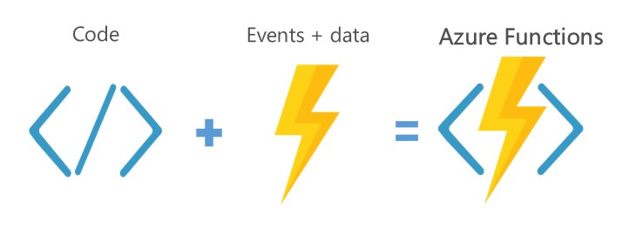
Notes:
H

Slide 13
Start in Portal (sandbox)
C#, F#, node.js, Python, PHP, Batch and more
Schedule event driven tasks
Expose as API endpoints
Auto-scaling (Horiz.)
H
Notes:
Henrik do this while Valdish show the portal

Slide 14
Use Case Study
H
Notes:
H

Slide 15


Slide 16
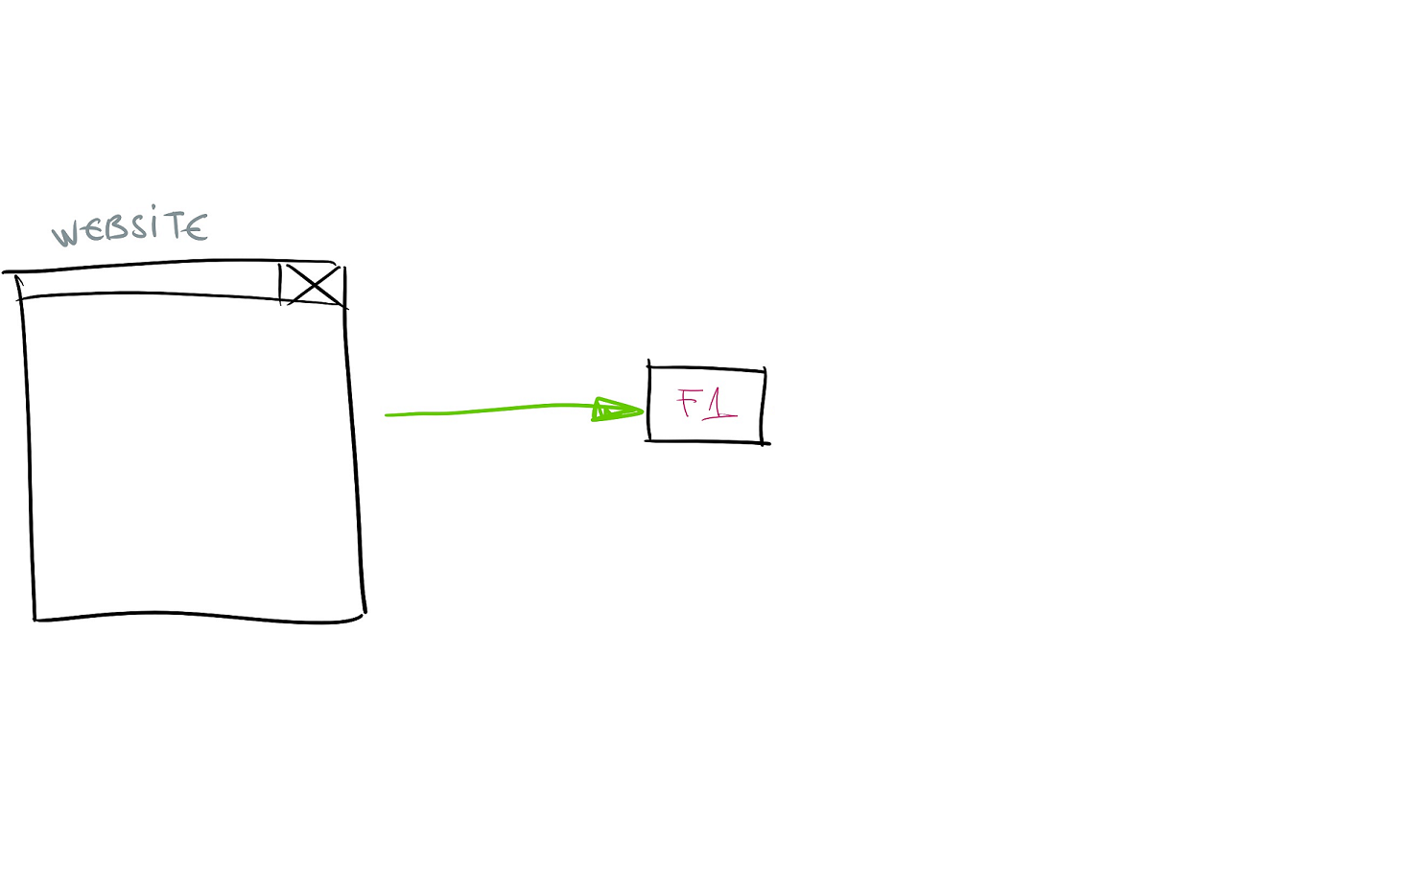

Slide 17
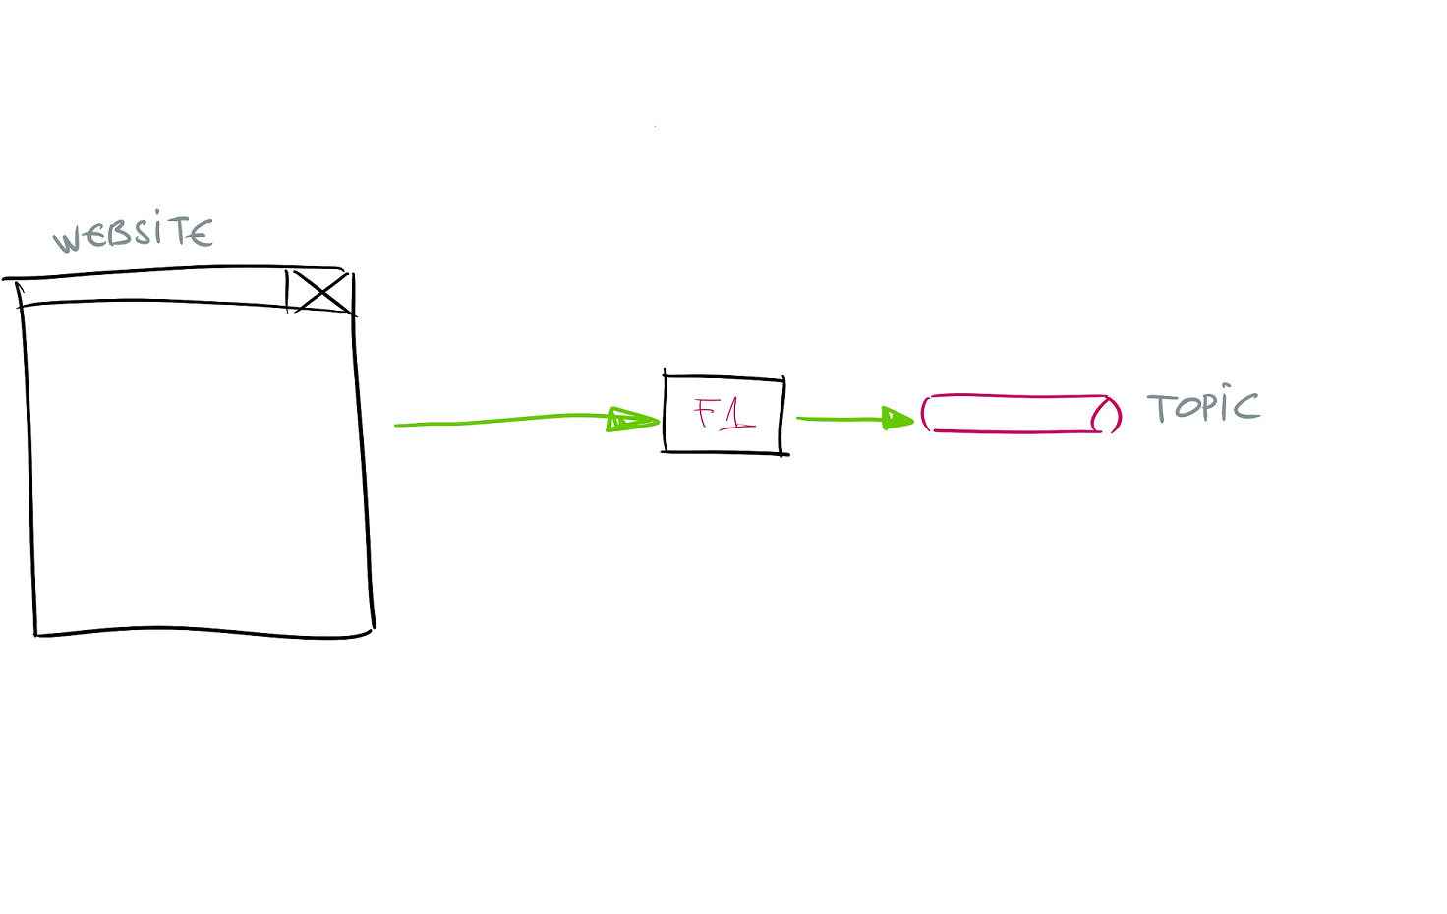

Slide 18
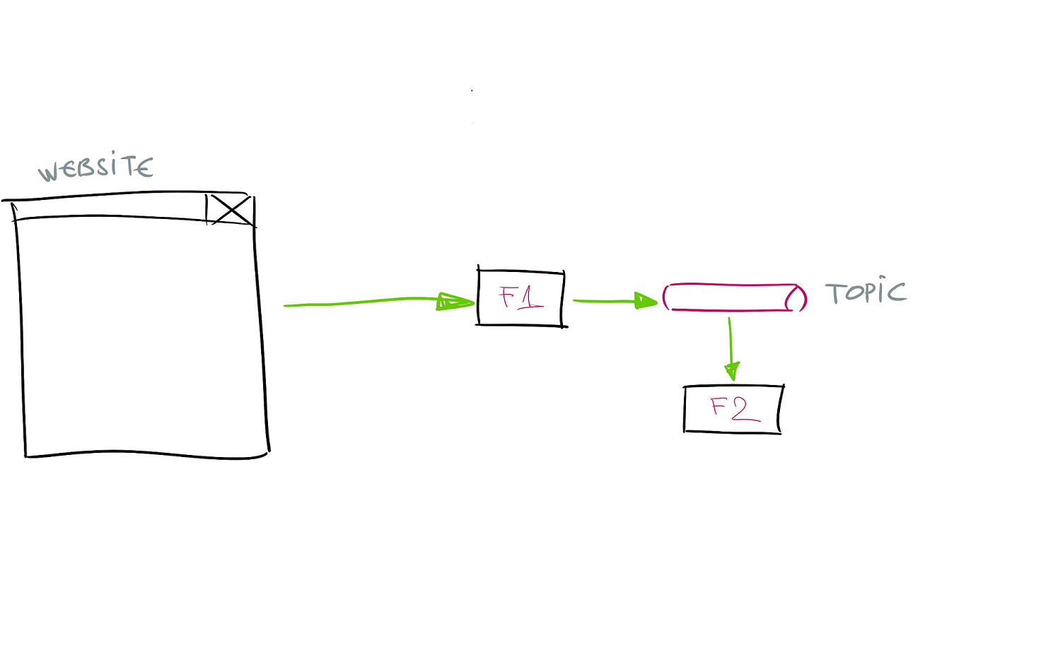

Slide 19
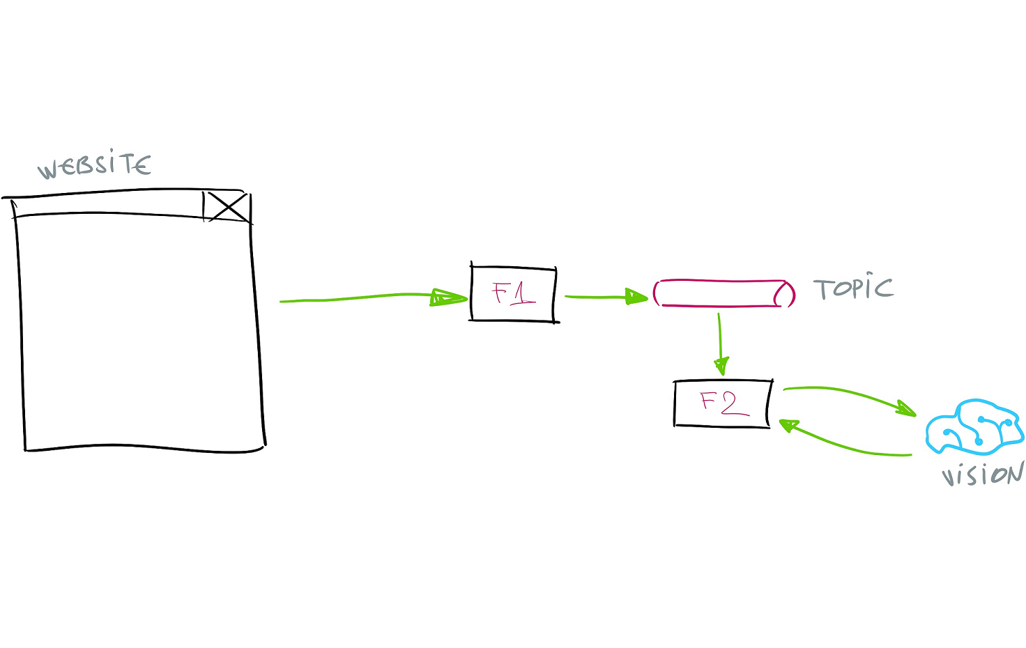

Slide 20


Slide 21





















Computer Vision
Speaker Regonition
Bing Web Search
Video Indexer
Speech Translation
Bing Custom Search
Custom Vision*
Text Analysis
Bing Video Search
Face
Bing Spell Check
Bing Image Search
Content Moderator
Language Understanding
Bing Visual Search
Speech to Text
Translator Text
Bing Entity Search
Text to Speech
QnA Maker
Bing News Search

Slide 23
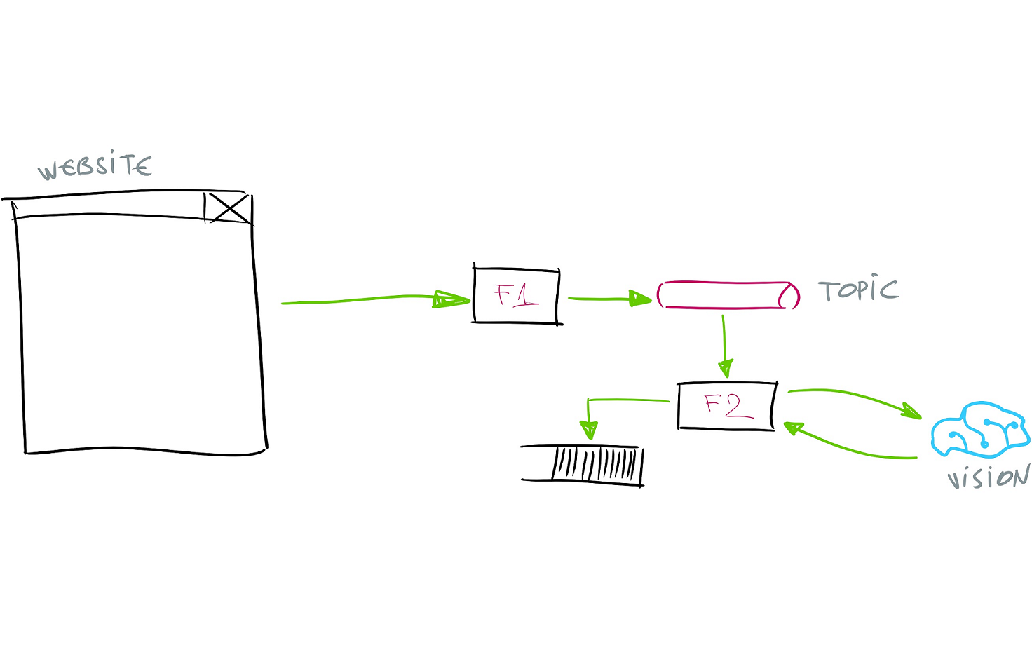

Slide 24
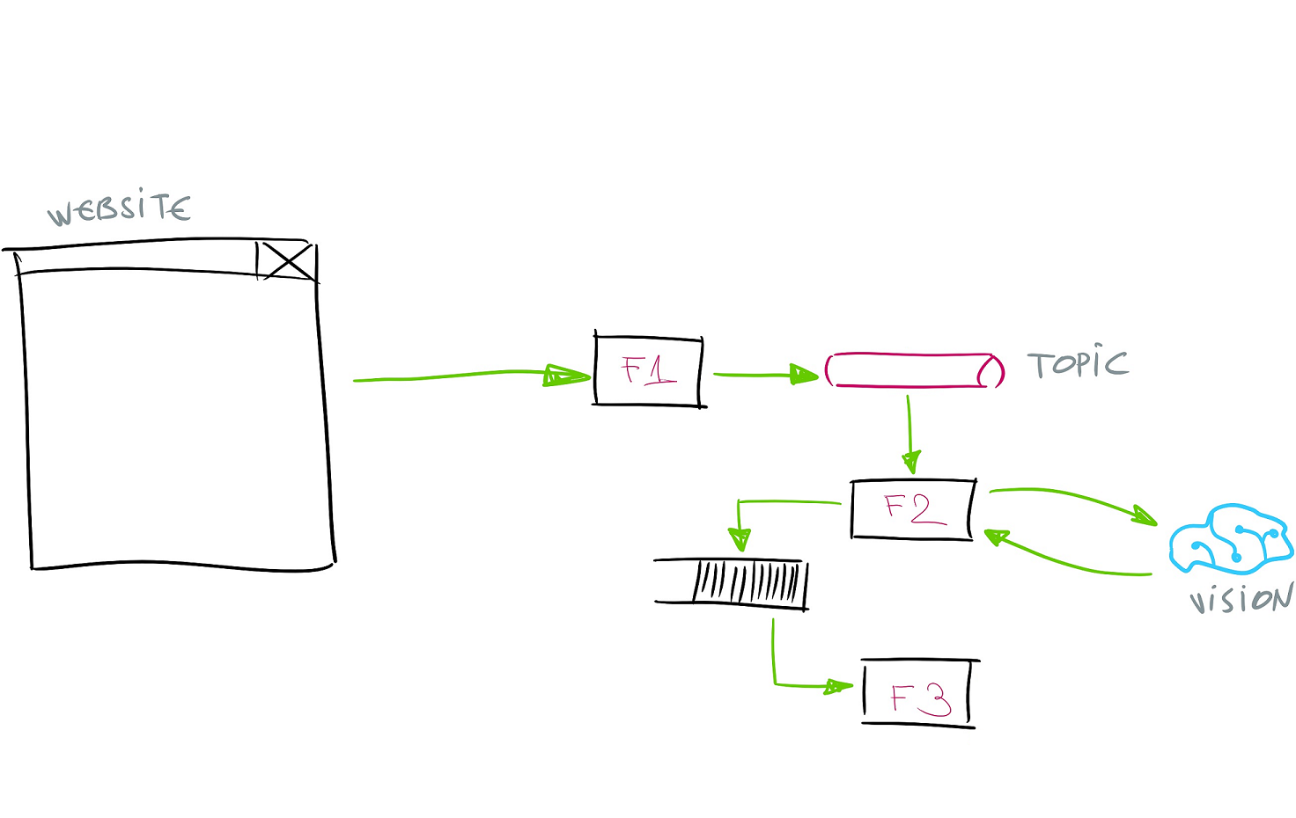

Slide 25
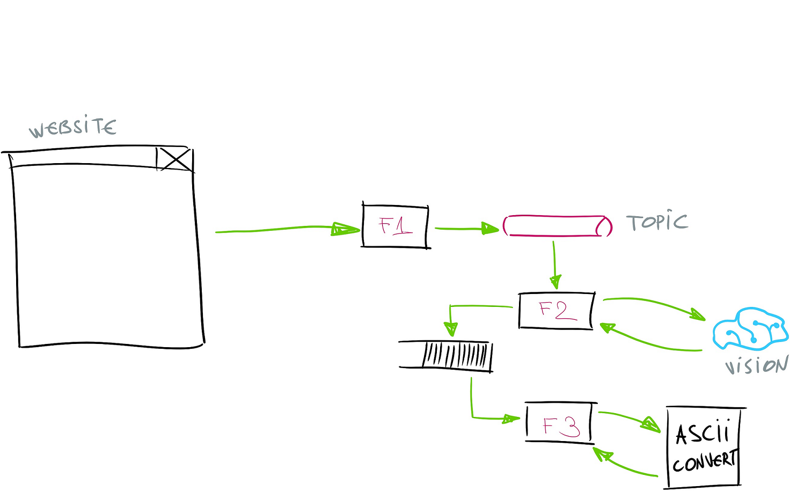

Slide 26
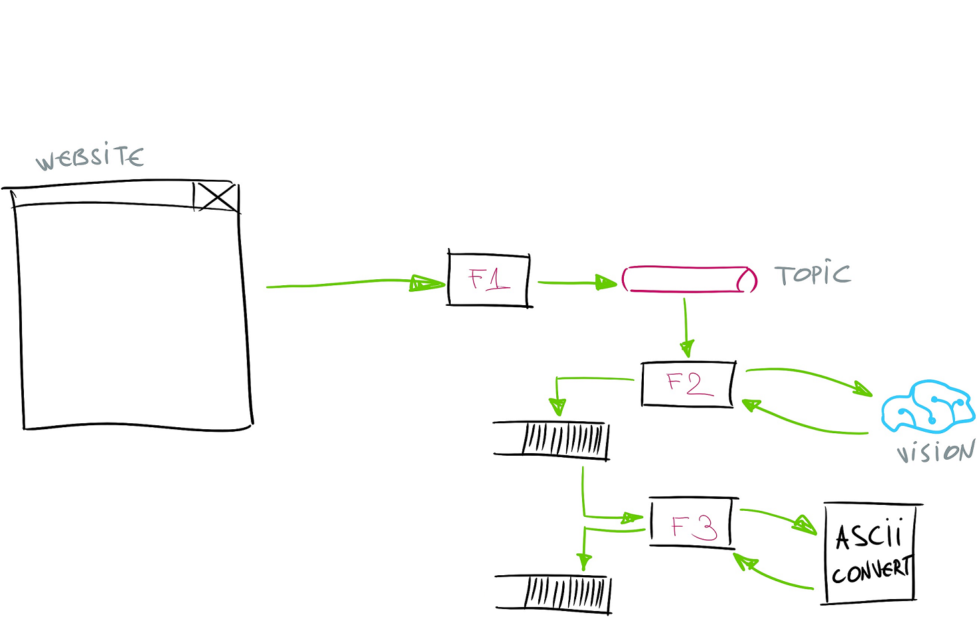

Slide 27
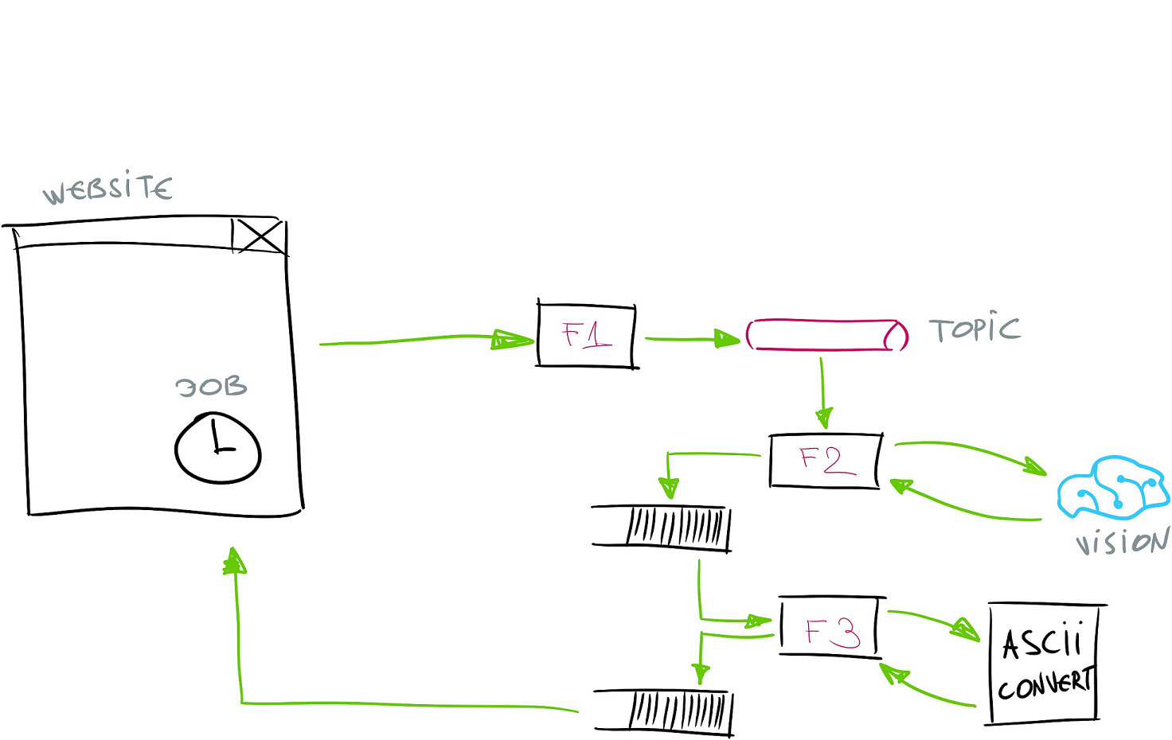

Slide 28
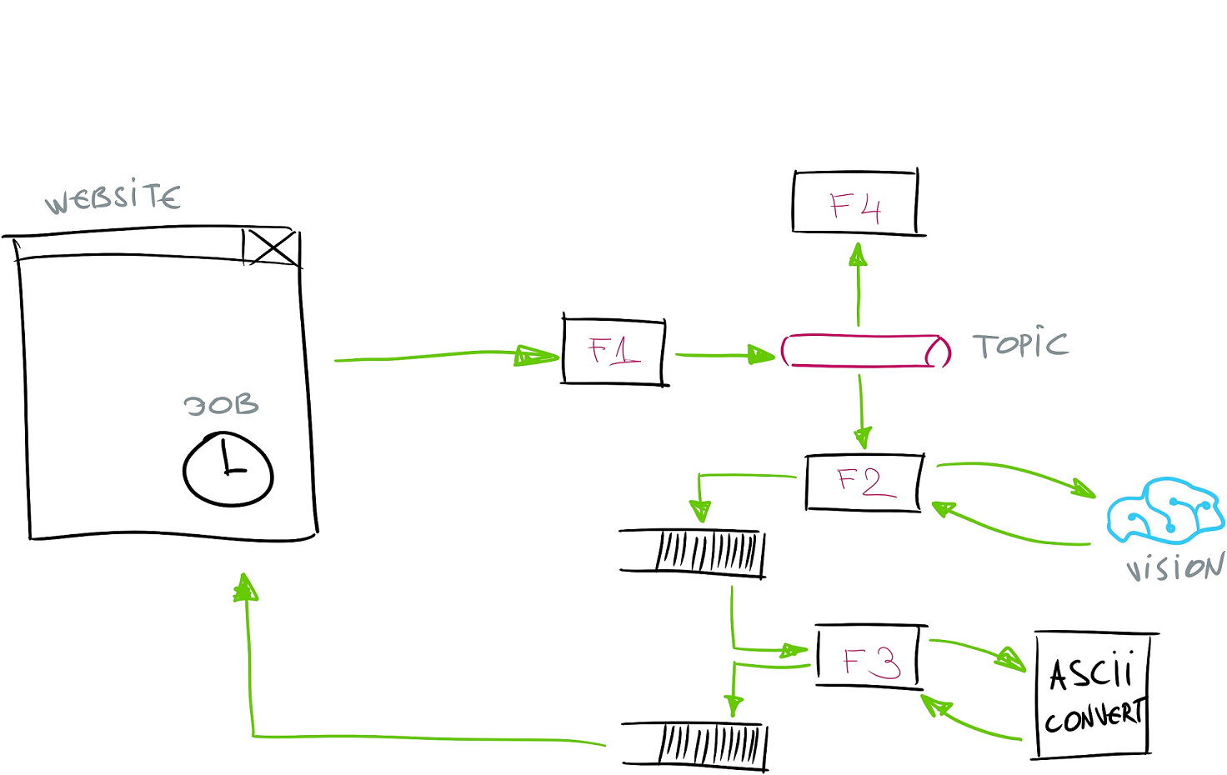

Slide 29
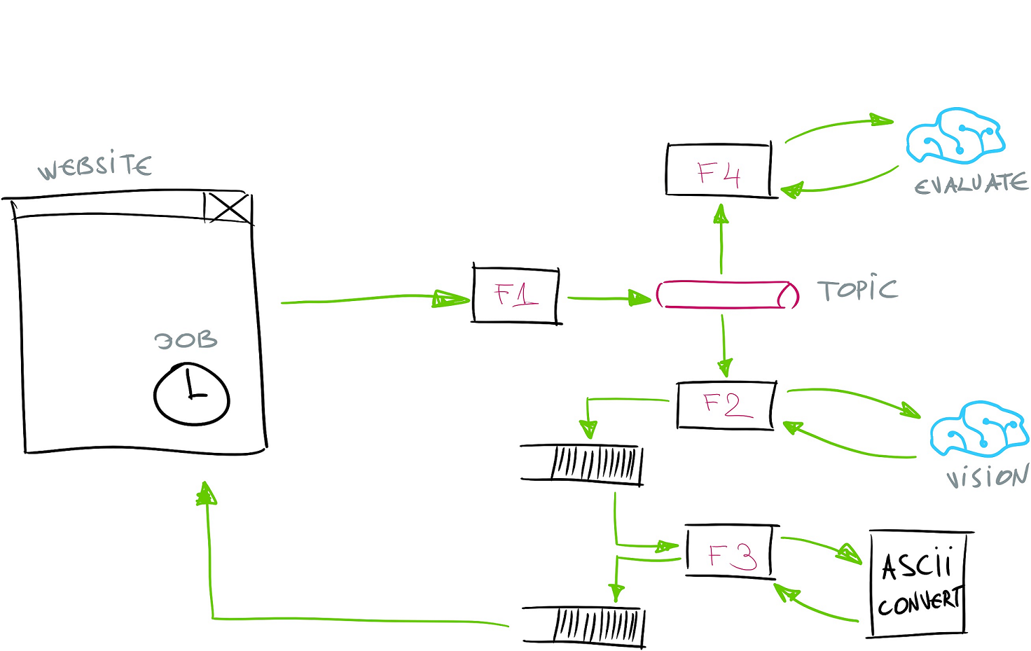

Slide 30
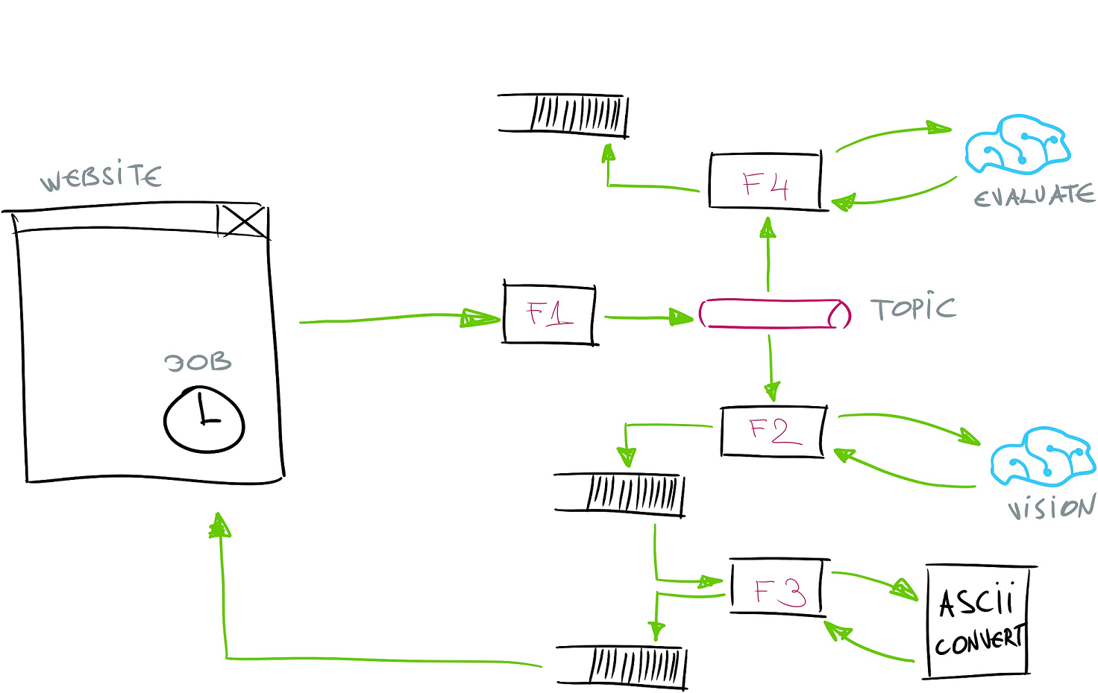

Slide 31
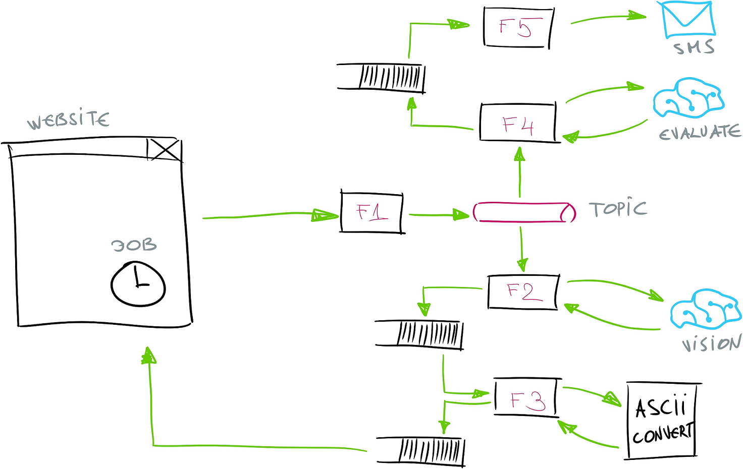

Slide 32
Azure Functions Billing
H
Notes:
H

Slide 33
> Consumption Plan
> Dedicated (App Service Plan)
H
Notes:
H

Slide 34
Benefits
H
Notes:
H

Slide 35
Scaling Costs
Reduced Operational Costs
Easier Management
H
Notes:
H
* - somebody takes care of your stuff
* - built used other services (commoditized)
* - Pay only for what you need
* - typical enterprise server utilizes only 5-15% of CPU / per year
* -

Slide 36
Drawbacks
Notes:
V

Slide 37
Vendor Lock-in
No In-server State
Startup Latency (Cold Start)
Execution Duration
API Endpoint Versioning (AzFunc Proxies)
Notes:
V

Slide 38
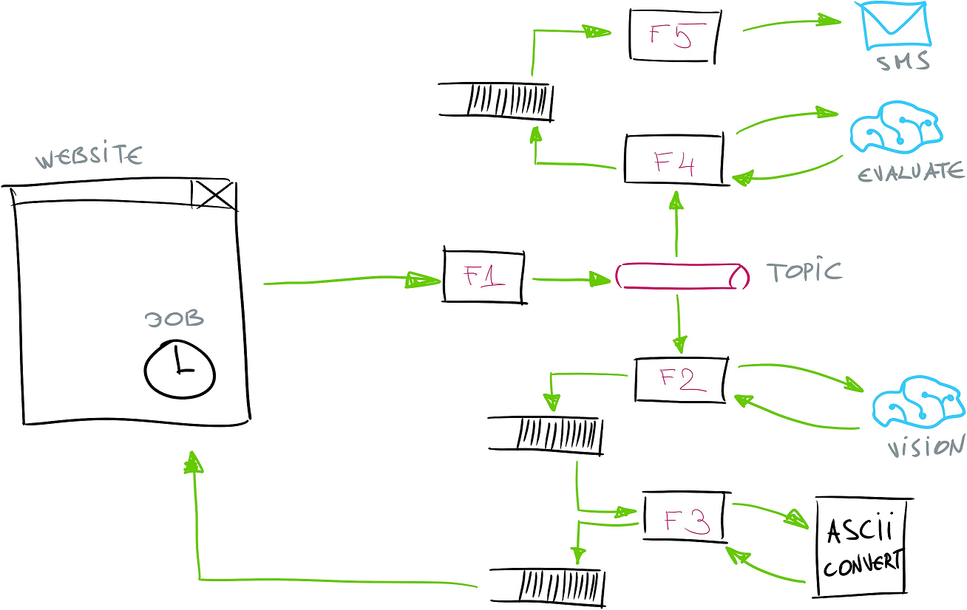




Slide 39
Durable Functions
Notes:
V

Slide 40
#r "Microsoft.Azure.WebJobs.Extensions.DurableTask"
public static async Task<AsciiArtResult>
Run(DurableOrchestrationContext context)
{
...
var analysisRequest = new AnalysisReq
{
BlobRef = outBlob.Name,
Width = request.Width
};
var resultFromF2 = await context.CallFunctionAsync<AsciiArtResult>(
"Function2",
analysisRequest);
...
return resultFromF2;
}
Notes:
V

Slide 41
#r "Microsoft.Azure.WebJobs.Extensions.DurableTask"
public static async Task<AsciiArtResult>
Run(DurableOrchestrationContext context)
{
...
var analysisRequest = new AnalysisReq
{
BlobRef = outBlob.Name,
Width = request.Width
};
var resultFromF2 = await context.CallFunctionAsync<AsciiArtResult>(
"Function2",
analysisRequest);
...
return resultFromF2;
}
Notes:
V

Slide 43
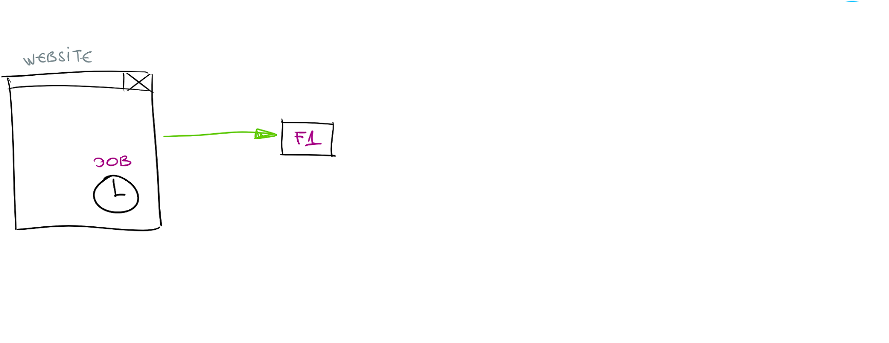

Slide 44
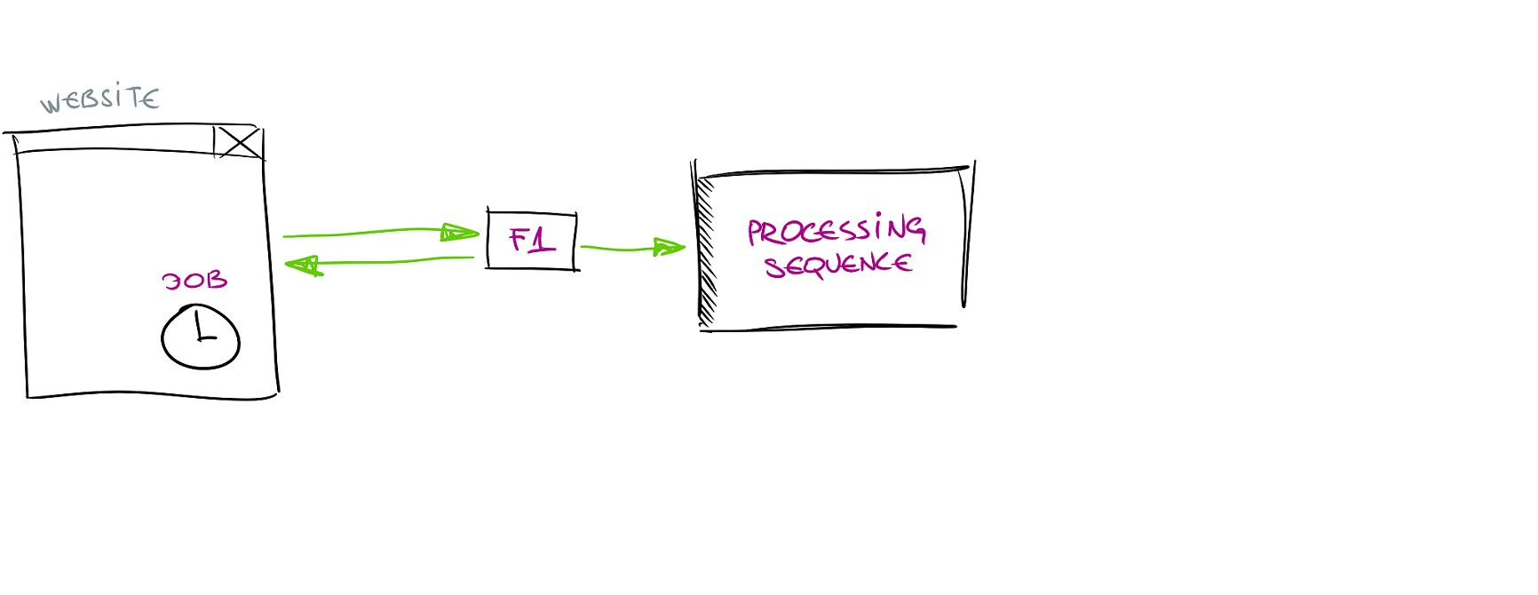

Slide 45
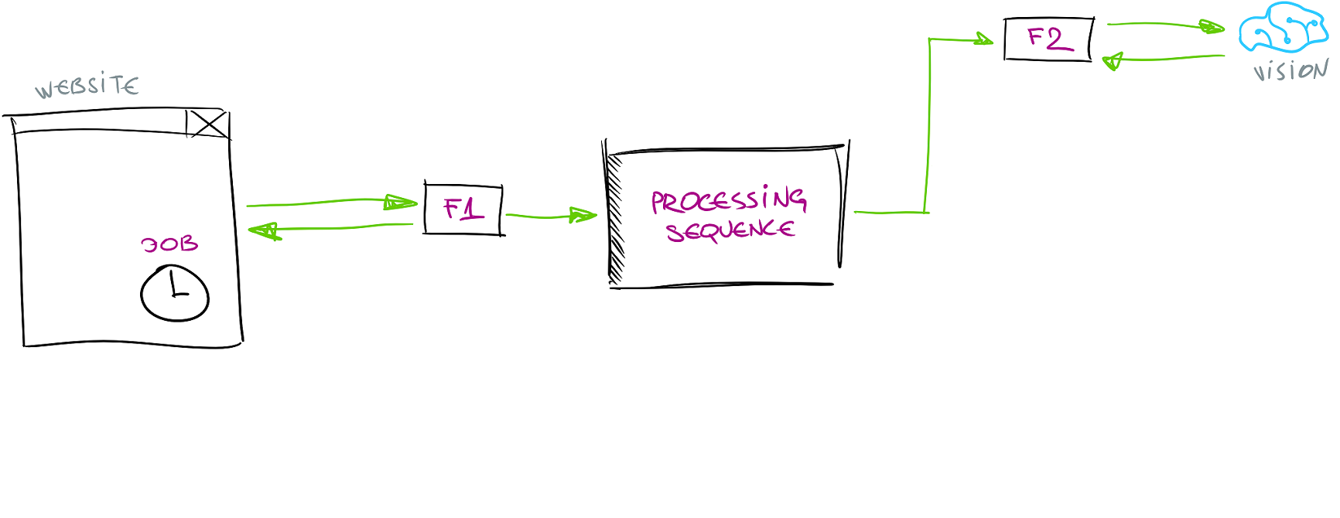

Slide 46
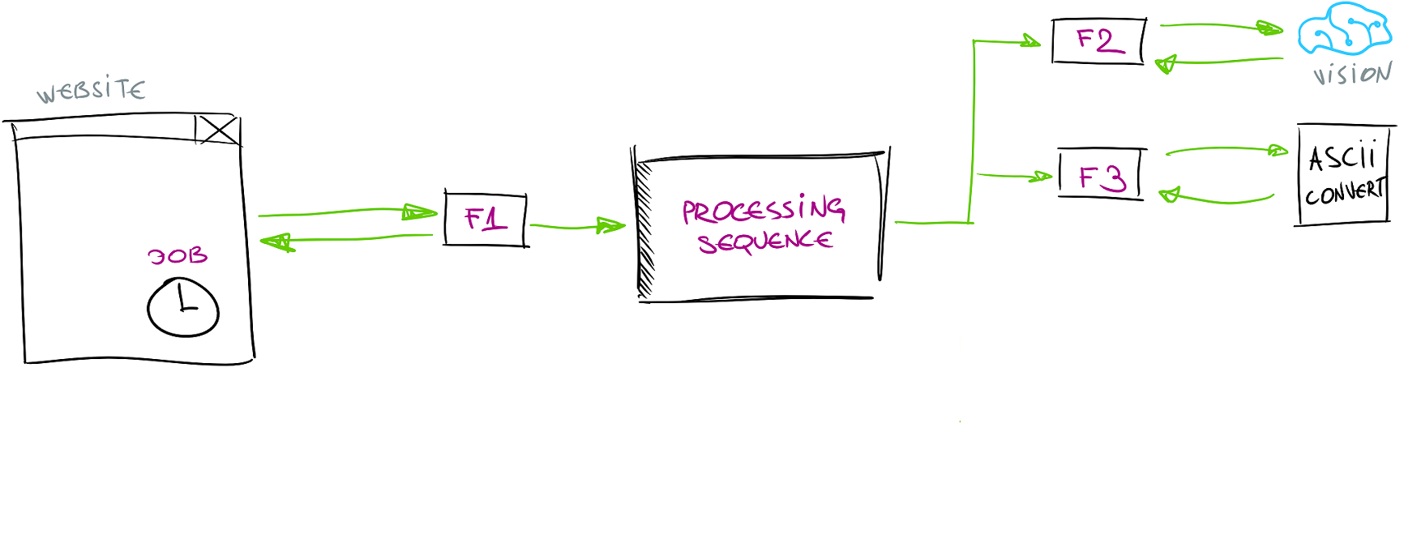

Slide 47
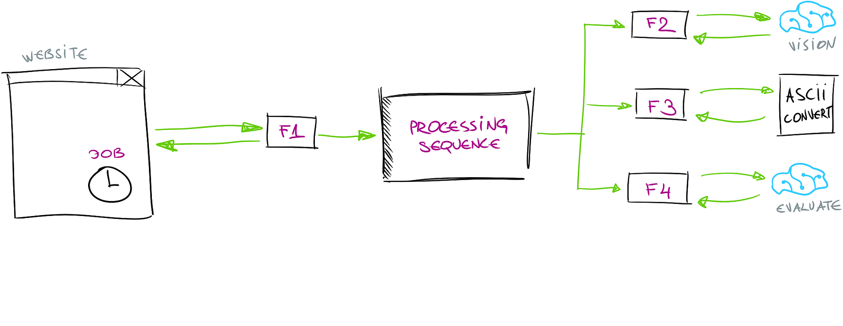

Slide 48
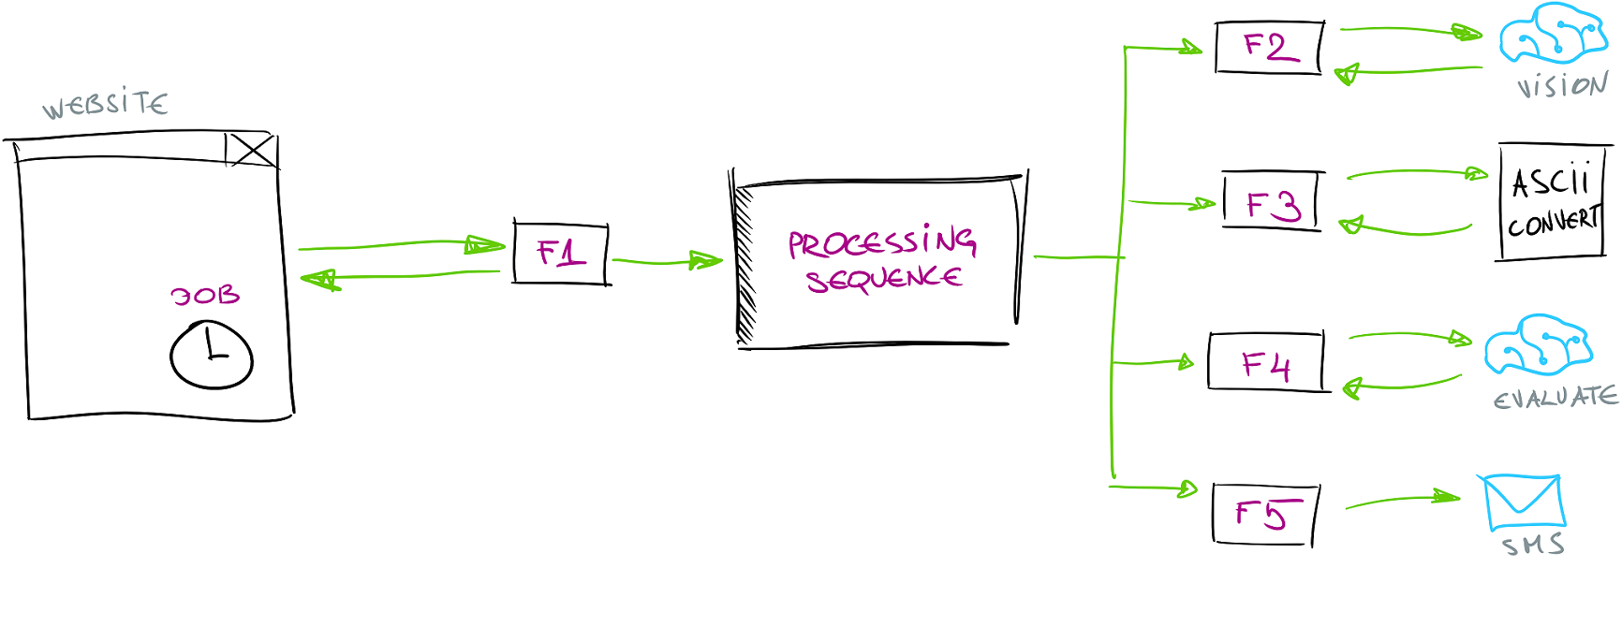

Slide 49
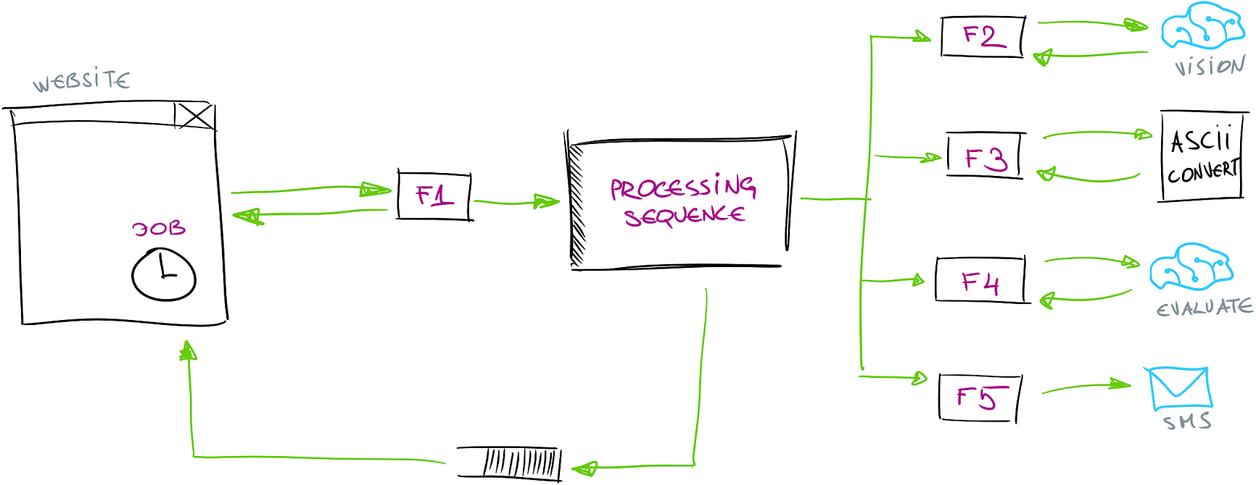

Slide 50
Cognitive Services Bindings
Notes:
V
https://functions-visualizer.azurewebsites.net/

Slide 51
public static async Task<CloudQueueMessage> Run(...)
{
var subscriptionKey = ConfigurationManager.AppSettings["cognitive-services-key"];
var serviceUri = ConfigurationManager.AppSettings["cognitive-services-uri"];
var client = new ComputerVisionClient(new ApiKeyServiceClientCredentials(subscriptionKey))
{
Endpoint = serviceUri
};
var result = await client.AnalyzeImageInStreamAsync(inBlob,
new[]
{
VisualFeatureTypes.Categories,
VisualFeatureTypes.Color,
VisualFeatureTypes.Description,
VisualFeatureTypes.Faces,
VisualFeatureTypes.ImageType,
VisualFeatureTypes.Tags
});

Slide 52
Install-Package
AzureFunctions.Extensions.CognitiveServices*
* - only in v2

Slide 53
public static class Function2
{
public static async Task<CloudQueueMessage> Run(
[ServiceBusTrigger("mytopic", "to-ascii", AccessRights.Manage)] AnalysisReq request,
[Blob("%input-container%/{BlobRef}", FileAccess.Read)] Stream inBlob,
[VisionAnalysis(Key = "%VisionKey%",
Url = "%VisionUrl%")] VisionAnalysisClient client,
TraceWriter log)
{
var result = await client.AnalyzeAsync(new VisionAnalysisClient(inBlob)
{
Options = VisualAnalysisOptions.Categories |
VisualAnalysisOptions.Color |
VisualAnalysisOptions.Description |
VisualAnalysisOptions.Faces |
VisualAnalysisOptions.ImageType |
VisualAnalysisOptions.Tags
});

Slide 54
How to draw diagram for serverless apps?
H
Notes:
H

Slide 56
Functions Visualizer
Notes:
V
https://functions-visualizer.azurewebsites.net/

Slide 57
functions-visualizer.azurewebsites.net*

Slide 58
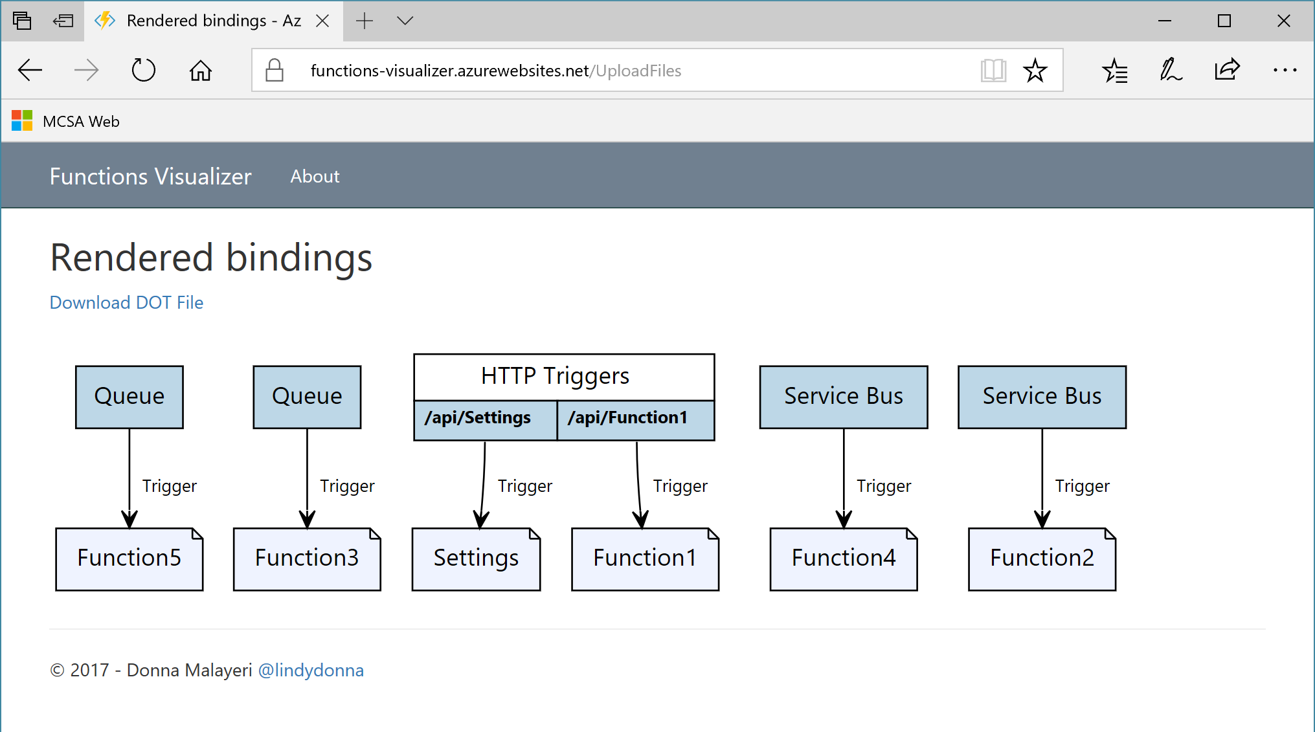

Slide 59
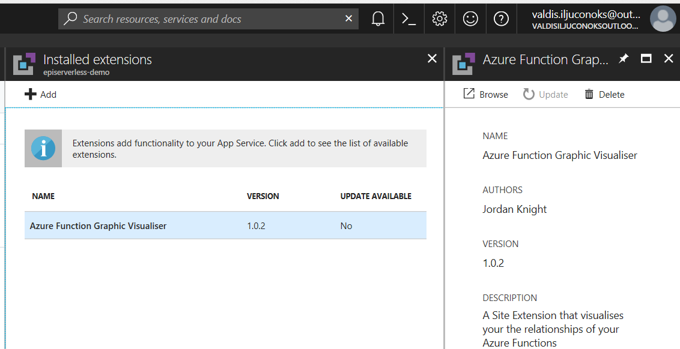

Slide 60
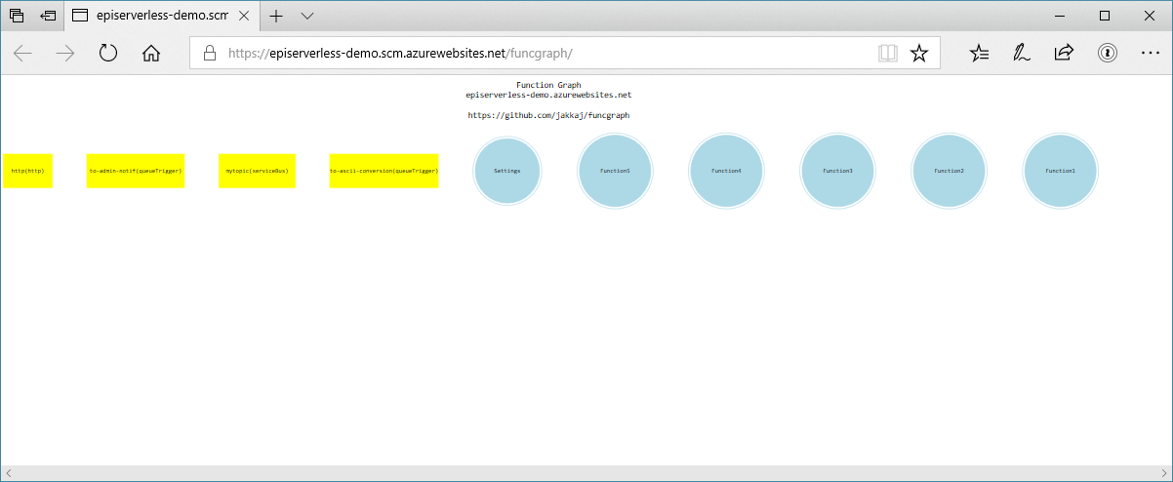

Slide 61
Function Best Practices
H
Notes:
H

Slide 62
Single thing (* not necessarily simple)
Defensive (survive duplicates)
Share connections
Persistant storage across functions
Finish ASAP or die
H
Notes:
H

Slide 63
valdis iljuconoks (aka technical fellow)
tech guy at getadigital.com
(Microsoft .Net + EPiServer) ◦ MVP
@tech_fellow

